Slide 1
Writing About Lighting in Film

Slide 2
Why is this important?
There will be a RAMPS EXAM in week 6 on close viewing of a short film.

Slide 3
How will points be awarded?
NOT ACHIEVED = name the film technique
ACHIEVED = name the film technique and describe it
MERIT = name the film technique, describe it and its purpose, write specifically about a point in the film where it is shown and links it to another film technique.
EXCELLENCE = name the film technique, describe it, write specifically about a point in the film where it is shown, links it to another technique in film, explain the director’s intention and the effect on the audience.

Slide 4
NOT ACHIEVED EXAMPLE
At the start of the movie Lovefield, there is soft natural lighting.

Slide 5
ACHIEVED EXAMPLE
At the start of the movie Lovefield, soft natural lighting is used to the scene look like a stormy day.

Slide 6
MERIT EXAMPLE
At the start of the movie Lovefield, soft natural lighting is used to the scene look like a stormy day. The purpose of natural lighting is to set the scene (or weather) to guide the viewer’s mood. The camera pans down to show a field of corn as slow piano music plays to introduce the viewer to the scene.

Slide 7
EXCELLENCE EXAMPLE
At the start of the movie Lovefield, soft natural lighting is used to the scene look like a stormy day. The camera pans down to show a field of corn as slow piano music plays to introduce the viewer to the scene. The effect of the stormy sky is to make the viewer concerned that something awful is about to happen. The director intended to create a contrast with the music which is restful and soothing.

Slide 8
5 STEPS
Name the technique
Effect of the technique
Purpose and place in the film
Viewer’s feelings
Director’s intention

Slide 9
5 STEPS
Name the technique
Effect of the technique
Purpose and place in the film
Viewer’s feelings
Director’s intention
Write this down and
learn it for homework

Slide 10
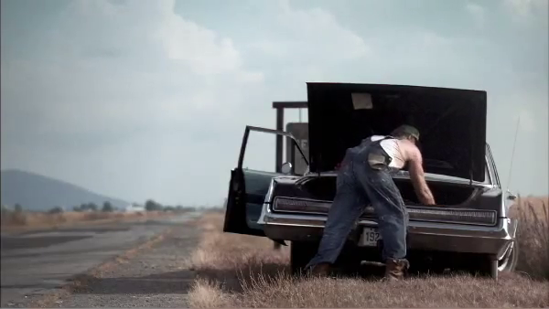
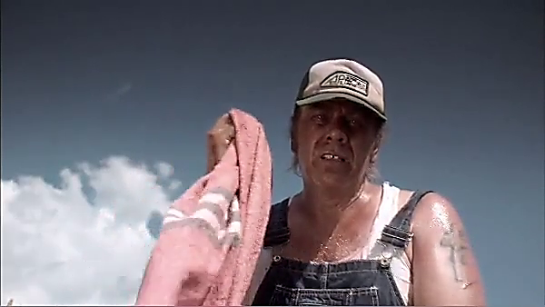
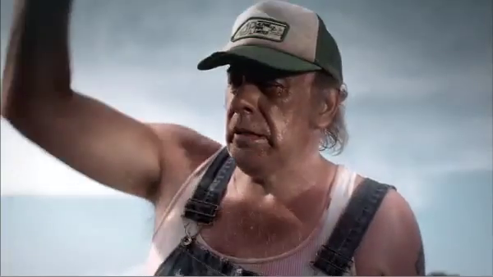
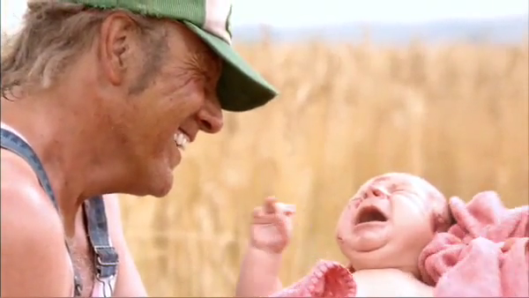
Write 5 steps about lighting in one of these pictures – remember NEPPViD

